Slide 1



TEAM GHANA / DAKAR 2026
01 • THE MISSION
THE MEDAL IS
NOT WORTH YOUR INTEGRITY.
GHANA
→
DAKAR
PRE-GAME ANTI-DOPING
EDUCATION AWARENESS ENGAGEMENT
YOUTH OLYMPIC QUALIFIERS • DAKAR, SENEGAL
ONE TEAM. ONE STANDARD.
PLAY TRUE • PROTECT YOUR DREAM

Slide 2

TEAM GHANA / DAKAR 2026
02 • WHY WE ARE HERE
YOU ARE REPRESENTING MORE THAN YOURSELF
Every choice in Dakar can protect — or damage — your future.
YOUR BODY
YOUR DREAM
YOUR COUNTRY
Your health comes first. No medal is worth preventable harm.
An anti-doping rule violation can cost eligibility, results and trust.
Represent Ghana with fairness, discipline and honesty.
Ask the room: “What does being a clean champion mean to you?”
PLAY TRUE • PROTECT YOUR DREAM

Slide 3
TEAM GHANA / DAKAR 2026
03 • THE 11 ADRVS
DOPING IS NOT JUST A POSITIVE TEST
There are 11 Anti-Doping Rule Violations (ADRVs) under the World Anti-Doping Code.
1 Presence of a prohibited substance
7 Trafficking or attempted trafficking
2 Use or attempted use
8 Administration or attempted administration
3 Evading, refusing or failing sample collection
9 Complicity or attempted complicity
4 Whereabouts failures*
10 Prohibited association
5 Tampering or attempted tampering
11 Discouraging or retaliating against reporting
6 Possession
*Whereabouts ADRV applies to athletes with specified Registered Testing Pool obligations. Source: ITA / 2021 WADA Code.
PLAY TRUE • PROTECT YOUR DREAM

Slide 4

TEAM GHANA / DAKAR 2026
04 • STRICT LIABILITY
“I DID NOT KNOW” IS NOT A SHIELD
Athletes are responsible for prohibited substances found in their samples.
?
“My coach gave it to me.”
“It was just a supplement.”
“I did not read the label.”
Rule: CHECK before you SWALLOW, INJECT, APPLY or USE.
PLAY TRUE • PROTECT YOUR DREAM

Slide 5
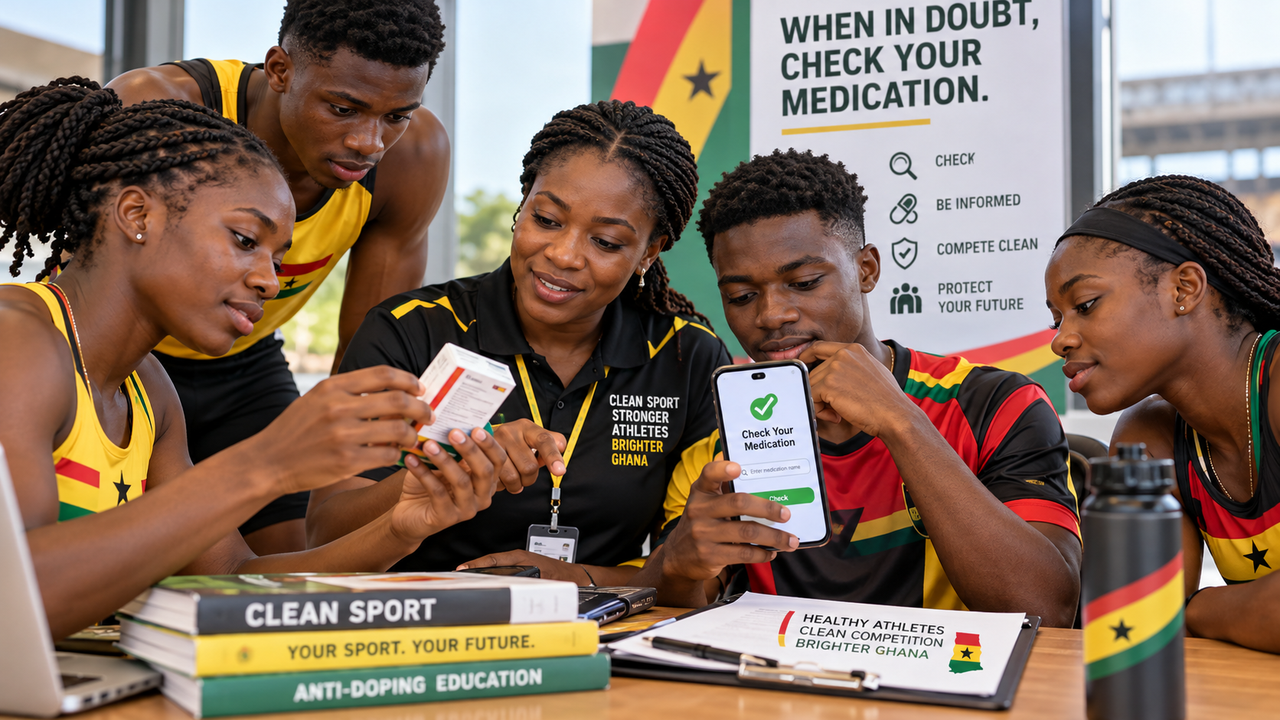
TEAM GHANA / DAKAR 2026
05 • CASE STUDY
GLOBAL DRO & MEDICATION CHECK
05 • MEDICATION SAFETY
Always check your medication if in doubt.
Use Global DRO before you take any medicine.
QUICK REMINDER
• Never take a tablet, syrup, inhaler, injection or supplement just because a friend recommends it.
• Ask the team doctor, physiotherapist or anti-doping lead.
• Search the medicine on Global DRO first.
• If still unsure, do not take it until you get proper advice.
CHECK • ASK • CONFIRM
Protect your health, your medal and your future.
Global DRO helps athletes check the anti-doping status of medications.
PLAY TRUE • PROTECT YOUR DREAM

Slide 6
TEAM GHANA / DAKAR 2026
06 • PROHIBITED LIST
WHAT IS PROHIBITED IN 2026?
The WADA Prohibited List is updated every year; some bans depend on timing or sport.
AT ALL TIMES
IN-COMPETITION
IN PARTICULAR SPORTS
Examples: anabolic agents; peptide hormones including EPO; certain hormone modulators; diuretics and masking agents.
Examples: stimulants; narcotics; cannabinoids; glucocorticoids by prohibited routes.
Some substances, such as beta-blockers, are prohibited in certain sports under specified conditions.
Never assume a medicine is safe because it is available at a pharmacy.
Source: WADA 2026 Prohibited List (effective 1 January 2026).
PLAY TRUE • PROTECT YOUR DREAM

Slide 7
TEAM GHANA / DAKAR 2026
07 • PROHIBITED METHODS
METHODS CAN BE BANNED TOO
Not all doping involves a tablet or an injection of a named substance.
M1 • BLOOD MANIPULATION
M2 • CHEMICAL / PHYSICAL
M3 • GENE / CELL
Blood doping and prohibited manipulation of blood components.
Sample tampering and prohibited intravenous infusions/injections beyond allowed rules.
Prohibited gene and cell doping to enhance sporting performance.
Emergency or legitimate medical care: tell the medical team immediately; documentation and TUE rules matter.
PLAY TRUE • PROTECT YOUR DREAM

Slide 8
TEAM GHANA / DAKAR 2026
08 • MEDICINE SAFETY
SICK? INJURED? DO NOT SELF-MEDICATE
The same medicine can have different anti-doping implications depending on its ingredients, route and timing.
1 Tell the doctor: “I am an athlete subject to testing.”
2 Check the exact product, ingredients, route and dosage.
3 Ask the team doctor / anti-doping lead about the current List.
4 Check whether a Therapeutic Use Exemption is needed.
5 Keep prescriptions and medical records.
Reference: WADA Prohibited List / ITA Dakar 2026 Athlete Guide.
PLAY TRUE • PROTECT YOUR DREAM

Slide 9
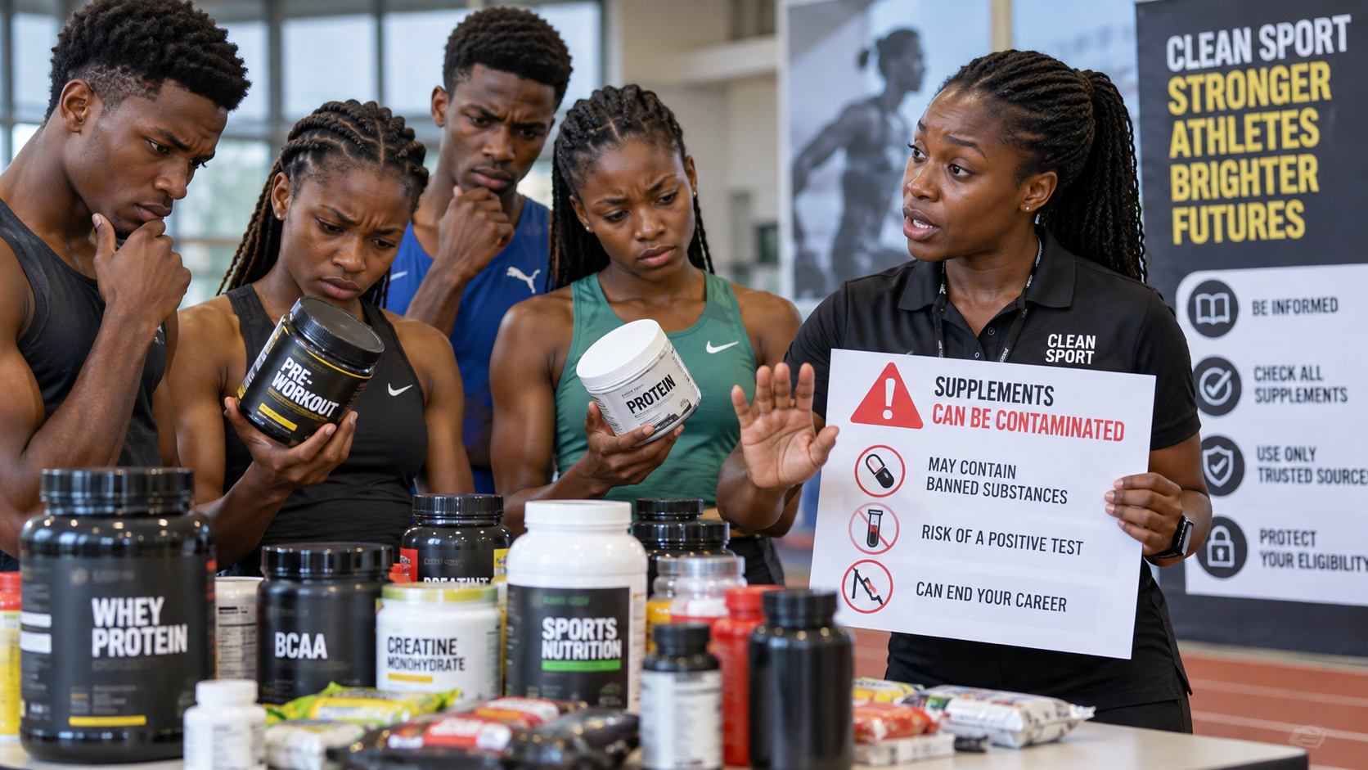
TEAM GHANA / DAKAR 2026
09 • SUPPLEMENTS
SUPPLEMENTS: A SHORTCUT CAN END A CAREER
A label saying “natural”, “herbal” or “approved” does NOT guarantee anti-doping safety.
THE RISK
THE SAFER CHOICE
Some products contain unlisted or contaminated substances. No supplement is completely risk-free.
Use a food-first approach. Ask a qualified sports nutrition professional. If use is necessary, minimise risk and document decisions.
Question: “Can WADA guarantee that a particular supplement is safe?” NO.
PLAY TRUE • PROTECT YOUR DREAM

Slide 10
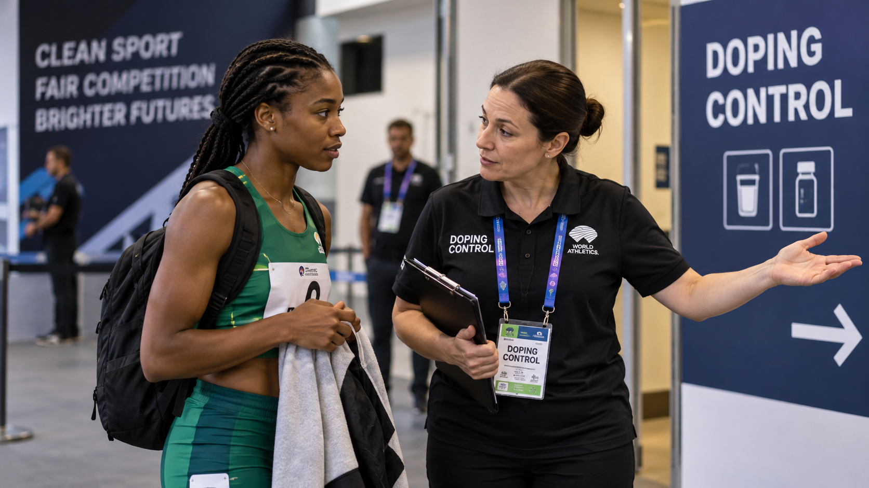
TEAM GHANA / DAKAR 2026
10 • RIGHTS
KNOW YOUR RIGHTS DURING TESTING
Being selected for doping control does NOT mean you are suspected of doping.
YOU CAN…
YOU MUST ALSO…
• Ask to see the DCO’s identification
• Receive an explanation of the process
• Request a representative (especially important for minors)
• Request an interpreter if available
• Ask about reasonable delays and accommodations
• Record concerns on the documentation
• Follow notification instructions
• Remain under observation as required
• Provide a valid sample
• Follow collection procedures
• Check your details and sample codes
• Cooperate respectfully with officials
Minors: special procedures and representation requirements apply. Ask questions.
PLAY TRUE • PROTECT YOUR DREAM

Slide 11
TEAM GHANA / DAKAR 2026
11 • TESTING JOURNEY
FROM NOTIFICATION TO THE LAB
Know the steps before your first test — and stay calm.
1
→
2
→
3
→
4
→
5
→
6
SELECTED
NOTIFIED
REPORT / WAIT
SAMPLE
SEAL / RECORD
LAB / RESULTS
Do not leave without authorisation. Carefully review your sample code and paperwork.
PLAY TRUE • PROTECT YOUR DREAM

Slide 12

TEAM GHANA / DAKAR 2026
12 • TUE
TUE = THERAPEUTIC USE EXEMPTION
A legitimate medical condition may require treatment involving a prohibited substance or method.
WHAT A TUE DOES
YOUR ACTION
A TUE can authorise specific prohibited treatment when the applicable medical criteria and approval rules are met.
Tell your team doctor early. Gather medical evidence. Confirm who reviews your application and whether it must be recognised for Dakar.
A prescription is NOT automatically a TUE. Apply in advance when required; emergency rules may differ.
PLAY TRUE • PROTECT YOUR DREAM

Slide 13
TEAM GHANA / DAKAR 2026
13 • TUE PATHWAY
TUE: 5 QUESTIONS BEFORE YOU TRAVEL
Work with the Team Ghana doctor and the responsible anti-doping organisation.
1
Is the medicine on the 2026 Prohibited List?
2
Is there a permitted alternative treatment?
3
Do I already hold a valid TUE?
4
Does the correct authority need to grant or recognise my TUE?
5
Do I have medical records and confirmation?
Do not wait until you arrive in Senegal to start asking these questions.
PLAY TRUE • PROTECT YOUR DREAM

Slide 14
TEAM GHANA / DAKAR 2026
14 • YOUR SUPPORT TEAM
YOUR SUPPORT PERSONNEL HAVE A ROLE
Coaches, doctors, physios, officials and parents should protect young athletes.
COACHES
MEDICAL TEAM
ATHLETES
No secret injections, “special boosters” or pressure to take unknown products.
Check medications, treatment records, routes and TUE needs.
Speak up. Ask before using anything. Report concerns safely.
Clean sport is a team culture — but athletes still carry personal responsibilities.
PLAY TRUE • PROTECT YOUR DREAM

Slide 15
TEAM GHANA / DAKAR 2026
15 • VIDEO LEARNING
WATCH • DISCUSS • REMEMBER
Click the green panels in presentation mode to open official ITA learning videos/resources.
▶ Youth athletes at major events
▶ Doping control process videos
▶ Athletes’ rights & responsibilities
▶ Dakar 2026 Athlete Guide
Presenter tip: preview the videos and select 2–4 minute clips before your live session.
PLAY TRUE • PROTECT YOUR DREAM

Slide 16
TEAM GHANA / DAKAR 2026
16 • RAPID-FIRE QUIZ
TRUE OR FALSE?
Get athletes from different federations to answer aloud.
1. “Only athletes who win medals are tested.”
2. “Refusing a doping test can be an ADRV.”
3. “If my doctor prescribes it, it is automatically permitted.”
4. “A supplement can be contaminated.”
5. “I can ask questions during sample collection.”
Answers: FALSE • TRUE • FALSE • TRUE • TRUE
PLAY TRUE • PROTECT YOUR DREAM

Slide 17

TEAM GHANA / DAKAR 2026
17 • FINAL PLEDGE
MAKE GHANA PROUD. STAY CLEAN.
Your best performance is one you can stand behind — today and years from now.
“I WILL COMPETE WITH
COURAGE, FAIRNESS
AND INTEGRITY.”
TEAM GHANA • PLAY TRUE
PLAY TRUE • PROTECT YOUR DREAM

Slide 18
TEAM GHANA / DAKAR 2026
18 • RESOURCES
TRUSTED SOURCES • CHECK BEFORE YOU ACT
Save these links and use them throughout the Games.
↗ ITA Dakar 2026 anti-doping guide
↗ ITA Dakar 2026 education guide
↗ WADA 2026 Prohibited List
↗ WADA ADEL education platform
↗ Ghana Anti-Doping Agency
THANK YOU TEAM GHANA
PLAY TRUE • PROTECT YOUR DREAM

